Slide 1
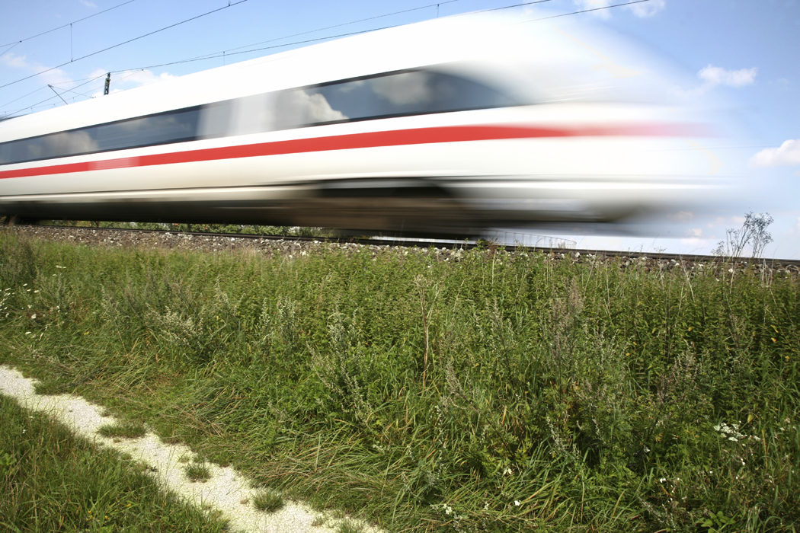

AP Physics
Chapter 2
Kinematics: Description of Motion

Slide 2
Homework for Chapter 2
Read Chapter 2
HW 2.A : pp. 57-59: 8,9,12,13,16,17,20,26,34,35,38,39.
HW 2.B: pp. 60-61: 46,47,48,50,52, 58,59,61,70,71,72-75,80.

Slide 3
Learning Objectives for Chapter 2
Students will understand the general relationships among position, velocity, and acceleration for the motion of a particle along a straight line so that given a graph of one of the kinematics quantities, position, velocity, or acceleration, as a function of time, they can:
  recognize in what time intervals the other two are positive, negative, or zero.
  identify or sketch a graph of each as a function of time.
Students will understand the special case of motion with constant acceleration so they can:
  write down expressions for velocity and position as functions of time.
  identify or sketch graphs of these quantities.

Slide 4
Warmup: Movin’ On
Acceleration refers to any change in an object’s velocity. Velocity not only refers to an object’s speed but also its direction. The direction of an object’s acceleration is the same as the direction of the force causing it.
***************************************************************
Complete the table below by drawing arrows to indicate the directions of the objects’ velocity and acceleration.
Description of Motion | Direction of Velocity | Direction of Acceleration
A ball is dropped from a ladder.
A car is moving to the right when the driver applies the brakes to slow down.
A ball tied to a string and being swung clockwise is at the top of its circular path.
A sled is pushed to the left causing it to speed up.
Physics Daily Warmup #19

Slide 5
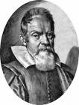
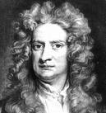
2.1 Distance and Speed: Scalar Quantities
Mechanics – the study of motion
  what produces and affects motion
  based on the work by Galileo and Newton
  divided into two parts:
  Kinematics – description of motion, not cause
    - The “how” of motion
    - Galileo’s work
  Dynamics – the causes of motion
    - the “why” of motion
    - Isaac Newton’s work
Galileo Galilei
Isaac Newton

Slide 6
2.1 Distance and Speed: Scalar Quantities
distance – the total path length in traveling from one position to another.
example: set your travel odometer to 0.0
- drive to school and home again
- your position is the same as the start
- your odometer reads the distance traveled
• Distance is a scalar quantity.
• scalar quantity – only has magnitude (size), not direction.
• remember to include units!
examples of scalars:
• 150 kg
• 20 s
• 100°C
• 80 km

Slide 7
2.1 Distance and Speed: Scalar Quantities
speed – the rate at which distance is travelled
• Speed is a scalar quantity
• SI units: m/s
• average speed – distance divided by time ave. sp. = d
t
• instantaneous speed – how fast something is moving at a particular instant in time
example: your car speedometer
example: You walk to Sunoco, 0.5 km away, then walk straight back. The whole trip took 20 min. What was your average speed?
1km /.33 hr = 3 km/hr

Slide 8
2.2 One-Dimensional Displacement and Velocity: Vector Quantities
displacement – how far and in what direction
  displacement is a vector
vector quantity – has magnitude AND direction
  represented by arrows
  the length of the arrow represents the magnitude
example: A Derry HS student walks from the Office to the Library, 16 m.
- Set up a Cartesian coordinate system with the student at the origin.
- Orient the motion along one of the axes.
initial position x₁ = 0.0 m x₁ x₂
final position x₂ = 16.0 m x 0.0 5.0 10.0 15.0 (meters)
Δ x = x₂ – x₁ where is Δ x the change in position, or displacement (Bold means it is a vector.)
Δ x = x₂ – x₁ = 16.0 m – 0.0 m
Δ x = + 16.0 m

Slide 9
2.2 One-Dimensional Displacement and Velocity: Vector Quantities
example: A student walks 12.0 m from the Library to the Guidance. What is her displacement?
initial position x₂ = 16.0 m x_{1 Office} x_{3 Guidance} x_{2 Library}
final position x₃ = 4.0 m x 0.0 5.0 10.0 15.0 (meters)
Δ x = x₃ – x₂
Δ x = x₃ – x₂ = 4.0 m – 16.0 m
Δ x = - 12.0 m

Slide 10
2.2 One-Dimensional Displacement and Velocity: Vector Quantities
velocity – how fast something is moving and in what direction
• speed is a scalar; velocity is a vector
• SI units are m/s
average velocity = displacement
time
v = Δ x = x – x_{o} or v = x or x = v t
Δ t t – t_{o} t
instantaneous velocity – how fast something is moving, and in what direction at a particular instant in time

Slide 11
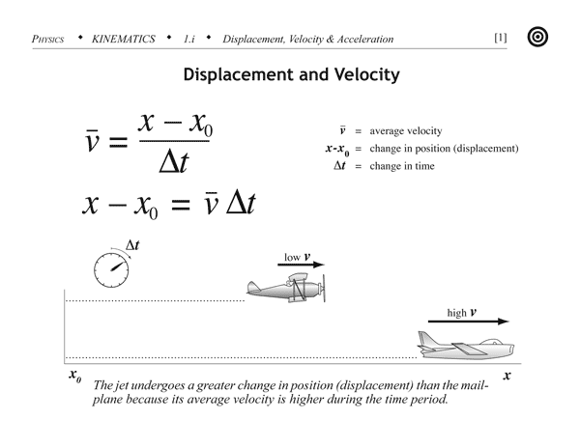
2.2 One-Dimensional Displacement and Velocity: Vector Quantities

Slide 12
2.2 One-Dimensional Displacement and Velocity: Vector Quantities
example: A Derry track team member does a wind sprint from the Library to the Office and back. His team mate times him at 12.30 s. What was his average speed? What was his average velocity?
Office = 0.0 m x_{1 Office} x_{2 Library}
Library = 16.0 m x 0.0 5.0 10.0 15.0 (meters)
ave. sp. = d = 32.0 m = 2.60 m/s
t 12.30 s
v = Δ x = 16.0 m – 16.0 m = 0.0 m/s
t 12.30 s

Slide 13
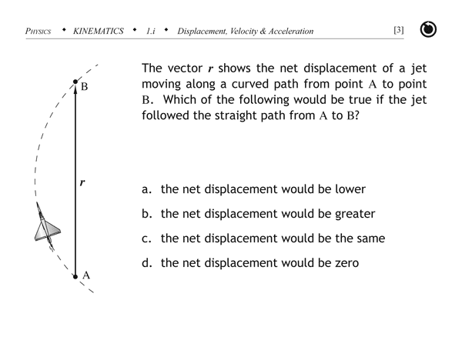
2.2 One-Dimensional Displacement and Velocity: Vector Quantities
Check for Understanding:

Slide 14
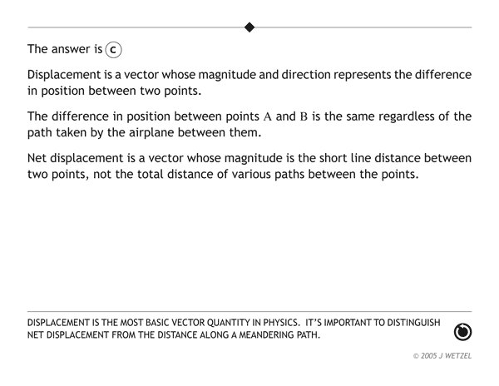

Slide 15
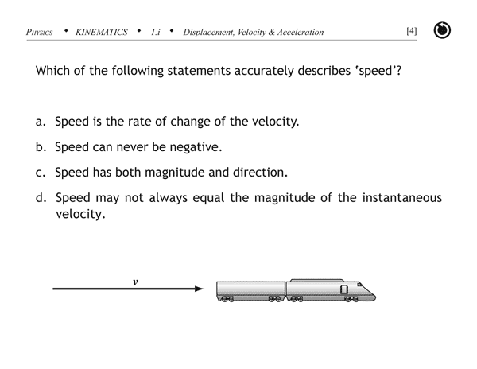
2.2 One-Dimensional Displacement and Velocity: Vector Quantities

Slide 16
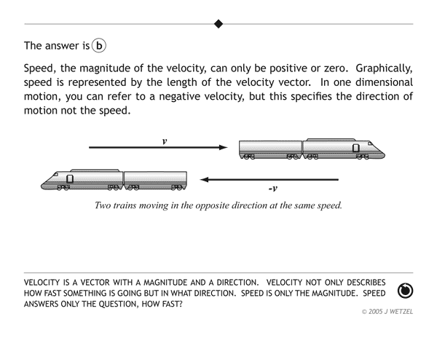

Slide 17
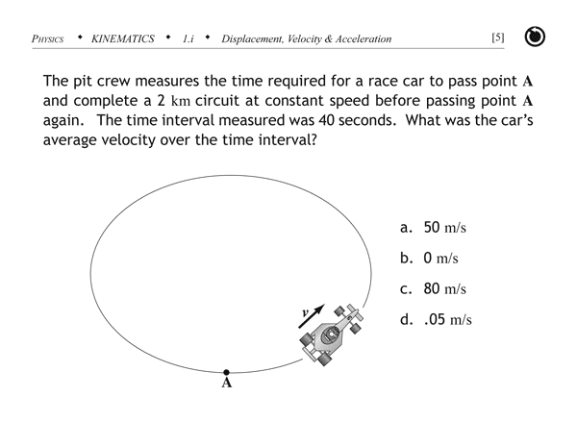
2.2 One-Dimensional Displacement and Velocity: Vector Quantities

Slide 18
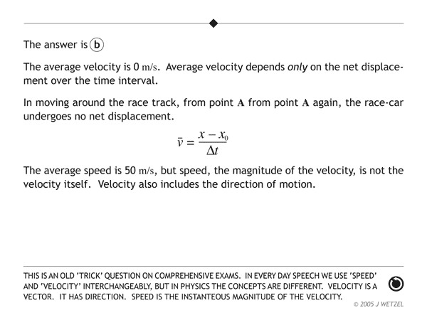

Slide 19
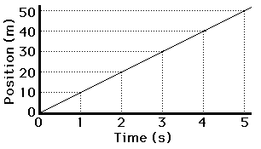

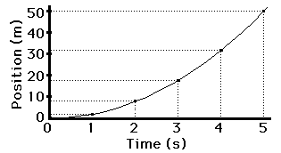

2.2 One-Dimensional Displacement and Velocity: Vector Quantities
Position vs. Time Graphs
Consider a car moving with a constant, rightward (+) velocity - say of +10 m/s.
Consider a car moving with a rightward (+), changing velocity - that is, a car that is moving rightward but speeding up or accelerating.

Slide 20
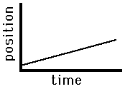
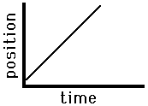
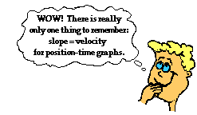
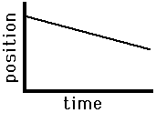
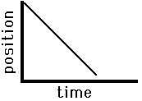
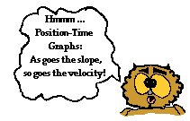
2.2 One-Dimensional Displacement and Velocity: Vector Quantities
Position vs. Time Graphs
Slow, Rightward(+) Constant Velocity | Fast, Rightward(+) Constant Velocity
Slow, Leftward(-) Constant Velocity | Fast, Leftward(-) Constant Velocity

Slide 21
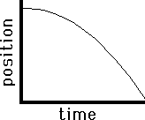
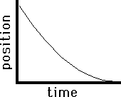
2.2 One-Dimensional Displacement and Velocity: Vector Quantities
Position vs. Time Graphs
x₁
x₂
Δ x
Δ t
t₁
t₂
To find average velocity during a time
period:
v = x₂ – x₁
t₂ – t₁
To find instantaneous velocity, find the slope of the tangent at a point on the curve.
v = slope = Δ x
Δ t

Slide 22
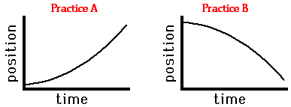
2.2 One-Dimensional Displacement and Velocity: Vector Quantities
Check for Understanding:
Use the principle of slope to describe the motion of the objects depicted by the two plots below. In your description, be sure to include such information as the direction of the velocity vector (i.e., positive or negative), whether there is a constant velocity or an acceleration, and whether the object is moving slow, fast, from slow to fast or from fast to slow. Be complete in your description.

Slide 23
2.2 One-Dimensional Displacement and Velocity: Vector Quantities
Position vs. Time Graphs: Check for Understanding
Practice A: The object has a positive or rightward velocity (note the + slope). The object has a changing velocity (note the changing slope); it is accelerating. The object is moving from slow to fast since the slope changes from small big.
Practice B: The object has a negative or leftward velocity (note the - slope). The object has a changing velocity (note the changing slope); it has an acceleration. The object is moving from slow to fast since the slope changes from small to big.

Slide 24
2.3 Acceleration
acceleration – the time rate of change of velocity
• acceleration is a vector quantity; SI units are m/s²
average acceleration = change in velocity
change in time
a = Δ v = v – v_{o} or a = v – v_{o}
Δ t t – t_{o} t
instantaneous acceleration – the acceleration at a particular instant in time

Slide 25
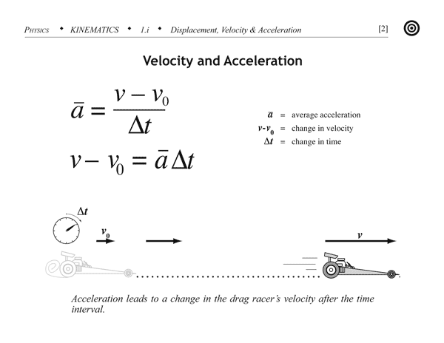
2.3 Acceleration

Slide 26
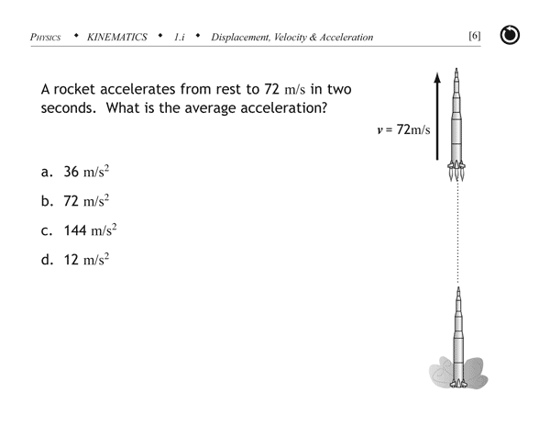
2.3 Acceleration

Slide 27
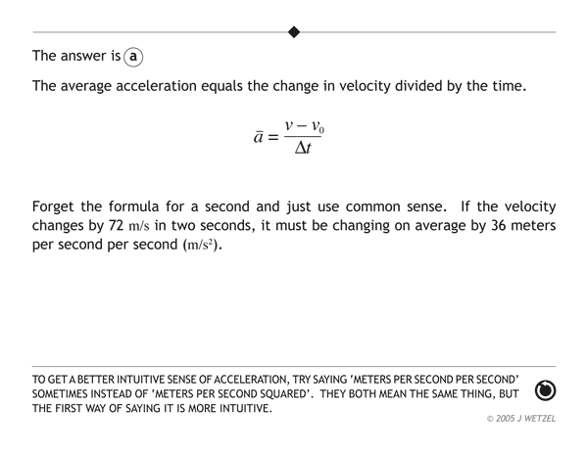

Slide 28
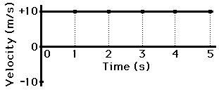
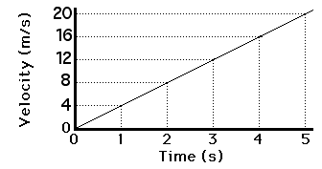
2.3 Acceleration
Velocity vs. Time Graphs
Consider a car moving with a constant, rightward (+) velocity - say of +10 m/s.
Consider a car moving with a rightward (+), changing velocity - that is, a car that is moving rightward but speeding up or accelerating.

Slide 29
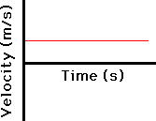
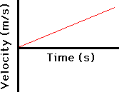
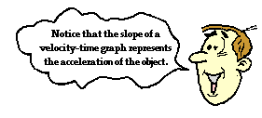
2.3 Acceleration
Velocity vs. Time Graphs
Positive Velocity Zero Acceleration | Positive Velocity Positive Acceleration
The area under the curve on a velocity vs. time graph represents displacement.

Slide 30
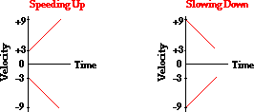
2.3 Acceleration
Velocity vs. Time Graphs
-x Signs of Velocity and Acceleration +x
a positive v negative Result: slower in the -x direction | a positive v positive Result: faster in the +x direction
a negative v negative Result: faster in the -x direction | a negative v positive Result: slower in the +x direction

Slide 31
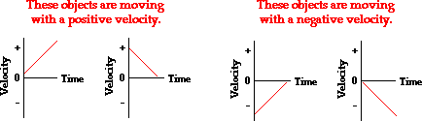
2.3 Acceleration
Velocity vs. Time Graphs
Acceleration vs. Time Graphs – draw for each of the above
Acceleration
- 0 +
Time
Acceleration
- 0 +
Time
Acceleration
- 0 +
Time
Acceleration
- 0 +
Time

Slide 32
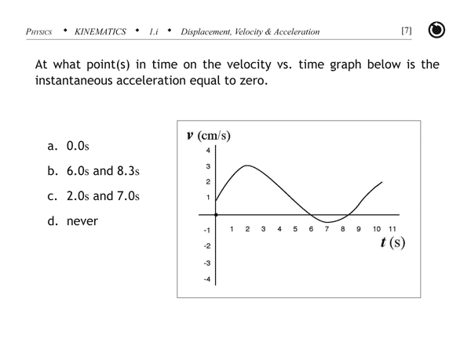
2.3 Acceleration

Slide 33
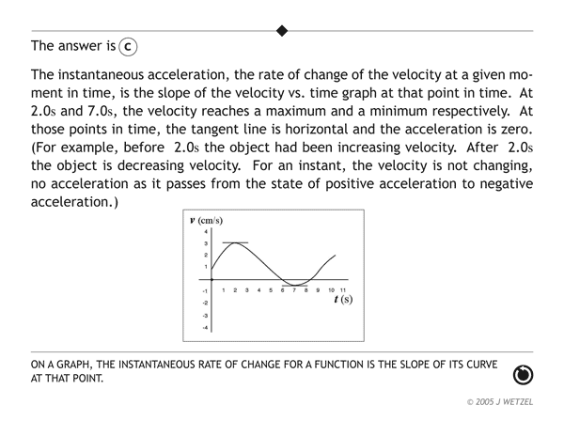

Slide 34

2.3 Acceleration
Check for Understanding:
Consider the graph at the right. The object whose motion is represented by this graph is ... (include all that are true):
moving in the positive direction.
moving with a constant velocity.
moving with a negative velocity.
slowing down.
changing directions.
speeding up.
moving with a positive acceleration.
moving with a constant acceleration.

Slide 35
2.3 Acceleration
Check for Understanding:
moving in the positive direction: TRUE since the line
is in the positive region of the graph.
b) moving with a constant velocity: FALSE since there is an
acceleration (i.e., a changing velocity).
c) moving with a negative velocity: FALSE since a negative
velocity would be a line in the negative region (i.e., below the horizontal axis).
d) slowing down: TRUE since the line is approaching the 0-velocity level (the x-axis).
e) changing directions: FALSE since the line never crosses the axis.
f) speeding up: FALSE since the line is not moving away from x-axis.
g) moving with a positive acceleration: FALSE since the line has a negative or downward slope.
h) moving with a constant acceleration: TRUE since the line is straight (i.e, has a constant slope).

Slide 36
Homework for Chapter 2
Sections 2.1, 2.2, 2.3
HW 2.A : pp. 57-59: 8,9,12,13,16,17,20,26,34,35,38,39.

Slide 37
Warmup: Which Velocity is It?
There are two types of velocity that we encounter in our everyday lives. Instantaneous velocity refers to how fast something is moving at a particular point in time, while average velocity refers to the average speed something travels over a given period of time.
For each use of velocity described below, identify whether it is instantaneous velocity or average velocity.
1. The speedometer on your car indicates you are going 65 mph. __________
2. A race-car driver was listed as driving 120 mph for the entire __________
race.
3. A freely falling object has a speed of 19.6 m/s after 2 seconds
of fall in a vacuum. __________
4. The speed limit sign says 45 mph. __________
instantaneous
average
instantaneous
instantaneous
Physics Daily Warmup #16

Slide 38
2.4 Kinematics Equations (Constant Acceleration)
• By combining the formulas and descriptions of motion we have learned so far, we can derive three basic equations.
1) velocity as a function of time
2) displacement as a function of time
3) velocity as a function of displacement
• Choose the equation that has three of your known variables, and solve for the unknown.

Slide 39
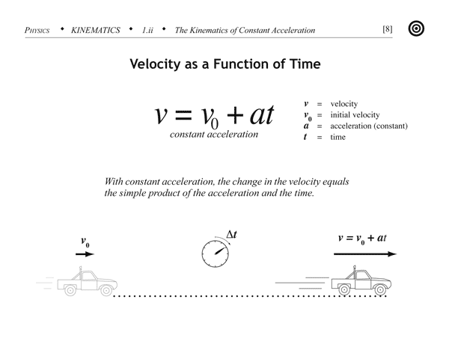
2.4 Kinematics Equations (Constant Acceleration)
1.

Slide 40
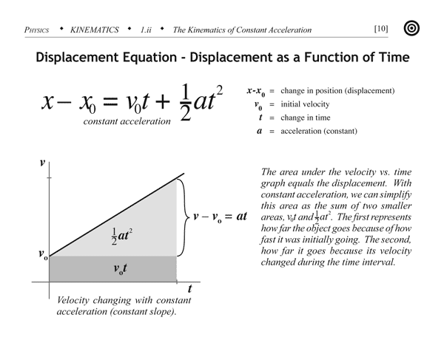
2.4 Kinematics Equations (Constant Acceleration)
2.

Slide 41
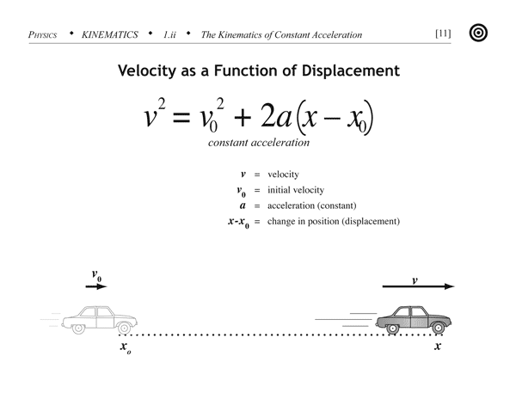
2.4 Kinematics Equations (Constant Acceleration)
3.

Slide 42
2.4 Kinematics Equations (Constant Acceleration)
Example: A rocket-propelled car begins at rest and accelerates at a constant rate up to
a velocity of 120 m/s. If it takes 6.0 seconds for the car to accelerate from rest to 60 m/s,
how long does it take for the car to reach 120 m/s, and how far does it travel in total?
Use Problem-Solving Strategy
Read the problem and analyze it. Write down knowns and unknowns.
v_{o} = 0 m/s a = ? (but we know the car goes from 0 to 60 m/s in 6 s)
v = 120 m/s t = ? (how long does it take for the car to reach 120 m/s?)
x - x_{o} = ? (how far does it travel in total?)
Sketch (Doesn’t really help in this problem, so skip it.)
Determine equations. All the kinematics equation require a, so calculate this first.
a = Δ v = 60 m/s = 10 m/s²
Δ t 6 s

Slide 43
Example: A rocket-propelled car begins at rest and accelerates at a constant rate up to
a velocity of 120 m/s. If it takes 6.0 seconds for the car to accelerate from rest to 60 m/s,
how long does it take for the car to reach 120 m/s, and how far does it travel in total?
v_{o} = 0 m/s
v = 120 m/s t = ? (how long does it take for the car to reach 120 m/s?)
a = 10 m/s² x - x_{o} = ? (how far does it travel in total?)
Equation 1 can be used to solve for t: Equation 2 can be used to solve for x-x_{o} :
v = v_{o} + at x = x_{o} + v_{o}t + ½ at²
v - v_{o} = at x – x_{o} = v_{o}t + ½ at²
t = v - v_{o} = 120 m/s – 0 m/s = 12 s x – x_{o} = (0 m/s) (12 s) + ½ (10 m/s²) (12 s)²
a 10 m/s² x – x_{o} = 720 m
Are the units right? Yes.
Are the sig figs correct? Yup.
Is the answer reasonable? Sure!
Great job!

Slide 44
2.4 Kinematics Equations (Constant Acceleration)
Summary
v = v_{o} + at velocity as a function of time
independent of displacement
x = x_{o} + v_{o}t + ½ at² displacement as a function of time independent of final velocity
v² = v_{o}² + 2a (x – x_{o}) velocity as a function of displacement
independent of time
Hints for Problem Solving
• Don’t panic!
• Work the problem; use a problem-solving strategy.
• Don’t overlook implied data.
ex: A car starting from rest has a v_{o} = 0 m/s

Slide 45
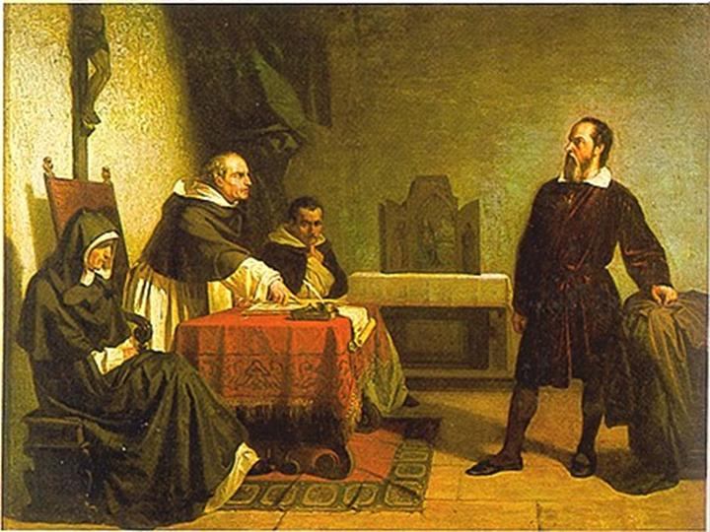
Warmup: Galileo Galilei and the Leaning Tower of Pisa
Read page 52 in your text and write a sentence about one interesting fact.
Galileo Galilei facing the Roman Inquisition, Cristiano Banti, 1857

Slide 46
2.5 Free Fall
• A common case of constant acceleration is due to gravity.
acceleration due to gravity (g) – 9.80 m/s² toward the center of the Earth.
- altitude affects g slightly
- air resistance affects the acceleration of a falling body
- not affected by the mass of an object
- estimate to 10 m/s² when you don’t have a calculator
free fall – objects in motion solely under the influence of gravity
- even objects projected upward are in free fall (neglecting air resistance)
Why?
• You may use the three kinematics equations to solve free fall problems.
- Be very careful about choosing a positive direction in your coordinate system.
- It is often helpful to divide vertical motion problems into two parts: on the way up and on the way down.
- Use implied data: If you throw an object up, at the maximum height the velocity is zero.

Slide 47
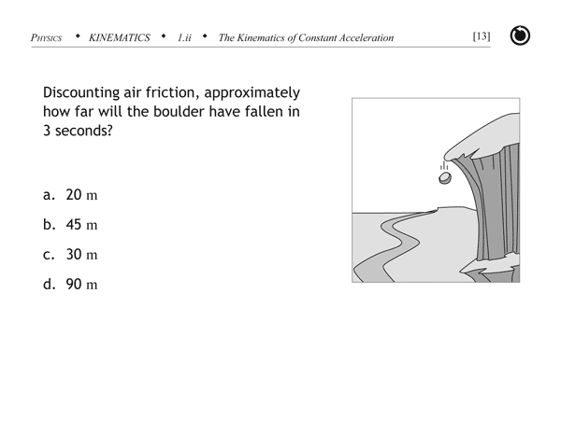
2.5 Free Fall

Slide 48
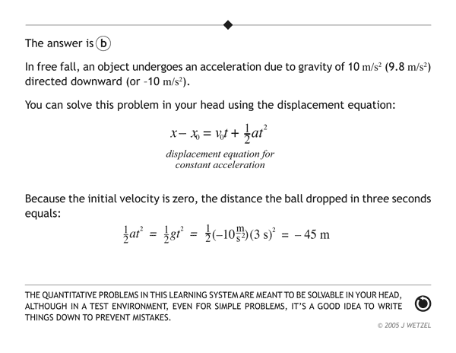

Slide 49
2.5 Free Fall
Example: You are standing on a cliff, 30 m above the valley floor. You throw a watermelon
vertically upward at a velocity of 3.0 m/s. How long does it take until the watermelon
hits the valley floor?
x+ ↑
Begin by defining coordinate axes.
We will call “up” positive.
Position zero is at the edge of the cliff.
30 m
v_{o} = 3.0 m/s v = ?
x – x_{o} = -30 m t = ?
a = -10 m/s²
Select a constant acceleration formula. If you are brave, pick number 2. However, you will have to solve a quadratic equation. Here’s another way:
Use formula 3: v² = v_{o}² + 2a (x – x_{o}) and solve for v. (be careful; v is negative)
v = [v_{o}² + 2a (x – x_{o})]^{1/2} = [ 9.0 m/s +2(-10 m/s²)(-30 m)]^{1/2} = -24.68 m/s
Now use formula 1: v = v_{o} + at → t = v – v_{o} = - 24.68 m/s – 3.0 m/s
a -10 m/s²
t = 2.8 s

Slide 50
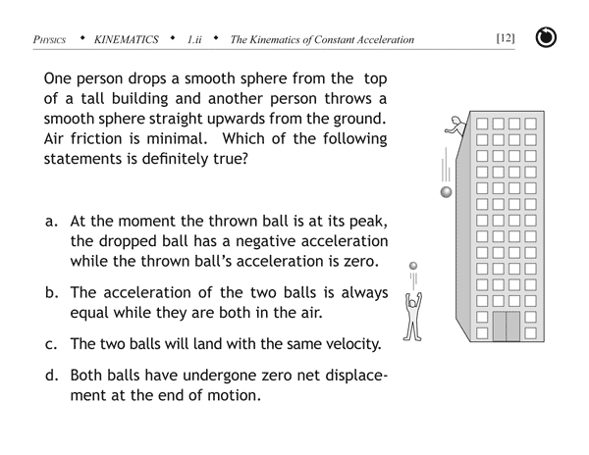
2.5 Free Fall: Check for Understanding

Slide 51
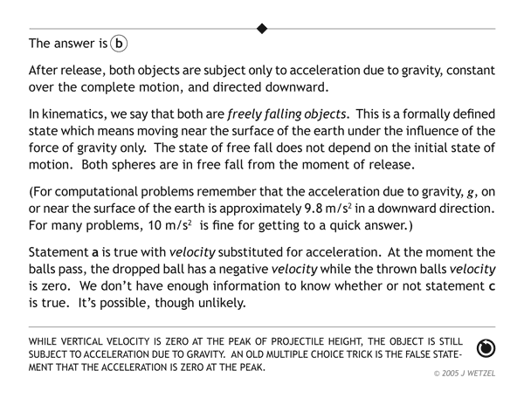

Slide 52
Homework for
Section 2.5
HW 2.B: pp. 60-61: 46,47,48,50,52, 58,59,61,70,71,72-75,80.

Slide 53
Formulas for Chapter 2
v = v_{o} + at
x = x_{o} + v_{o}t + ½ at²
v² = v_{o}² + 2a(x - x_{o})
x = position
v = velocity or speed
a = acceleration
t = time

